Slide 1
COMPUTER NETWORKS CSE 319 + 320
HASAN TAHSIN RAFSAN 18101009 MD. EFTI KHAIRUL ALAM 18101014 TANVEER AHAMED RABBY 18101025
A1 SECTION | 3RD YEAR | 2ND SEMESTER

Slide 2
LIGHTWEIGHT CERTIFICATELESS KEY AGREEMENT FOR SECURE IoT COMMUNICATION

Slide 3
introductory terms
Cryptography
Key
Private Key
Public Key
IoT
Secure Communication
Lightweight

Slide 4
what is LIKE
Authenticated key agreement characterized by:
ephemeral cryptographic materials;
support for intermittent connectivity with the TTP;
lightweight rekeying operations;
robustness against impersonation attacks, even when information stored on the TTP are leaked.
To prevent secret information leakage & gap in high toll on budget Like is used

Slide 5
background
CL-PKC scheme can be summarized in seven distinct phases:
Setup
Partial-Private-Key-Extract
Set-Secret-Value
Set-Private-Key
Set-Public-Key
Encrypt
Decrypt

Slide 6
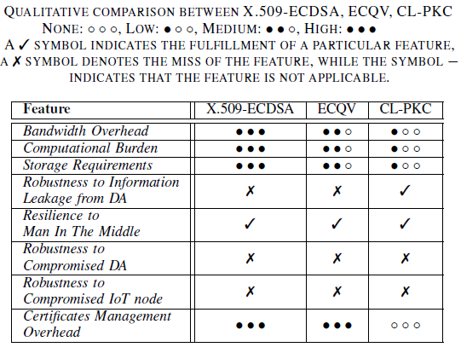
related works compare to CL-PKC

Slide 7
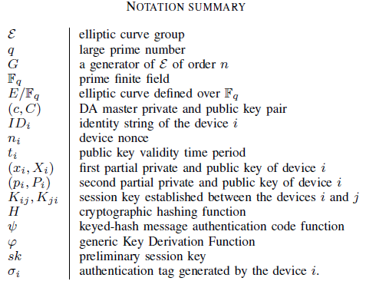
notation

Slide 8
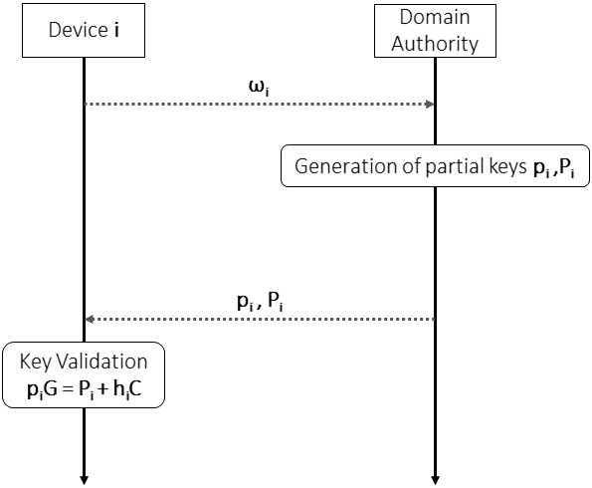
how LIKE protocols works
LIKE: Sequence Diagram of the Setup Phase

Slide 9
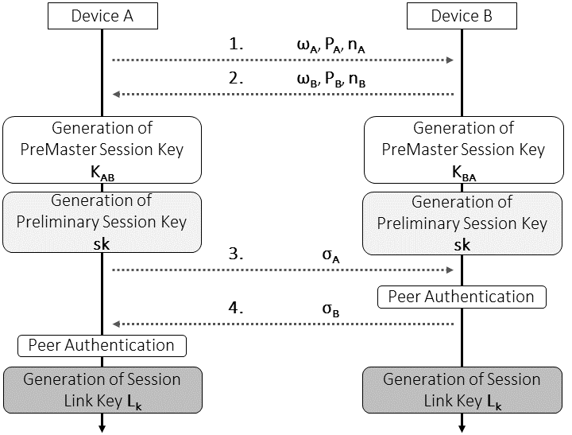
how LIKE protocols works
LIKE: Sequence Diagram of the Key Agreement Phase

Slide 10
security consideration
A. Security Properties
Protection Against Leakage of Secret DA Information
Ephemeral Cryptography Materials
Protection Against Man-in-the-Middle Attacks
Protection Against Replay Attacks
Protection Against Known-Key Attacks
Considerations on Energy-Depletion Attacks

Slide 11

security consideration
B. Formal verification with ProVerif
Security Verification of LiKe when the private keys of the involved devices are assumed to be secret.
ProVerif is an open-source tool

Slide 12
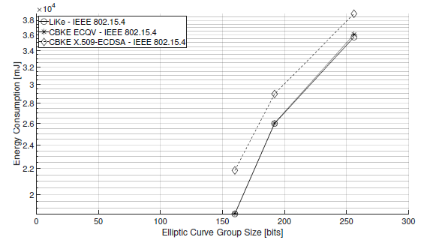
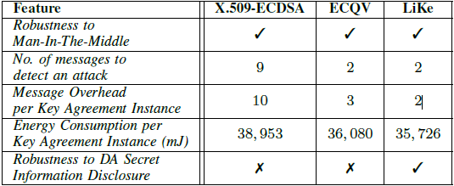
performance comparison
Energy consumption on each device involved in the key agreement, by considering X.509-ECDSA, ECQV, & LiKe, using different elliptic curves.
COMPARISON OF LIKE AGAINST CBKE APPROACHES BASED ON X.509-ECDSA & ECQV, ASSUMING A 256-BIT ELLIPTIC CURVE

Slide 13
conclusion
LiKe is a pairing-free and energy-friendly scheme, that does not need a persistent connection with a trusted authority during the key agreement.
Reported by our research paper, it completes all the key agreement instances in about 3.259 seconds , minimum message overhead & very limited energy consumption.

Slide 14
THANK YOU

